Slide 1



California Power Generation & Power sources
Who Run THE WORLD energy PROJECT

Slide 2
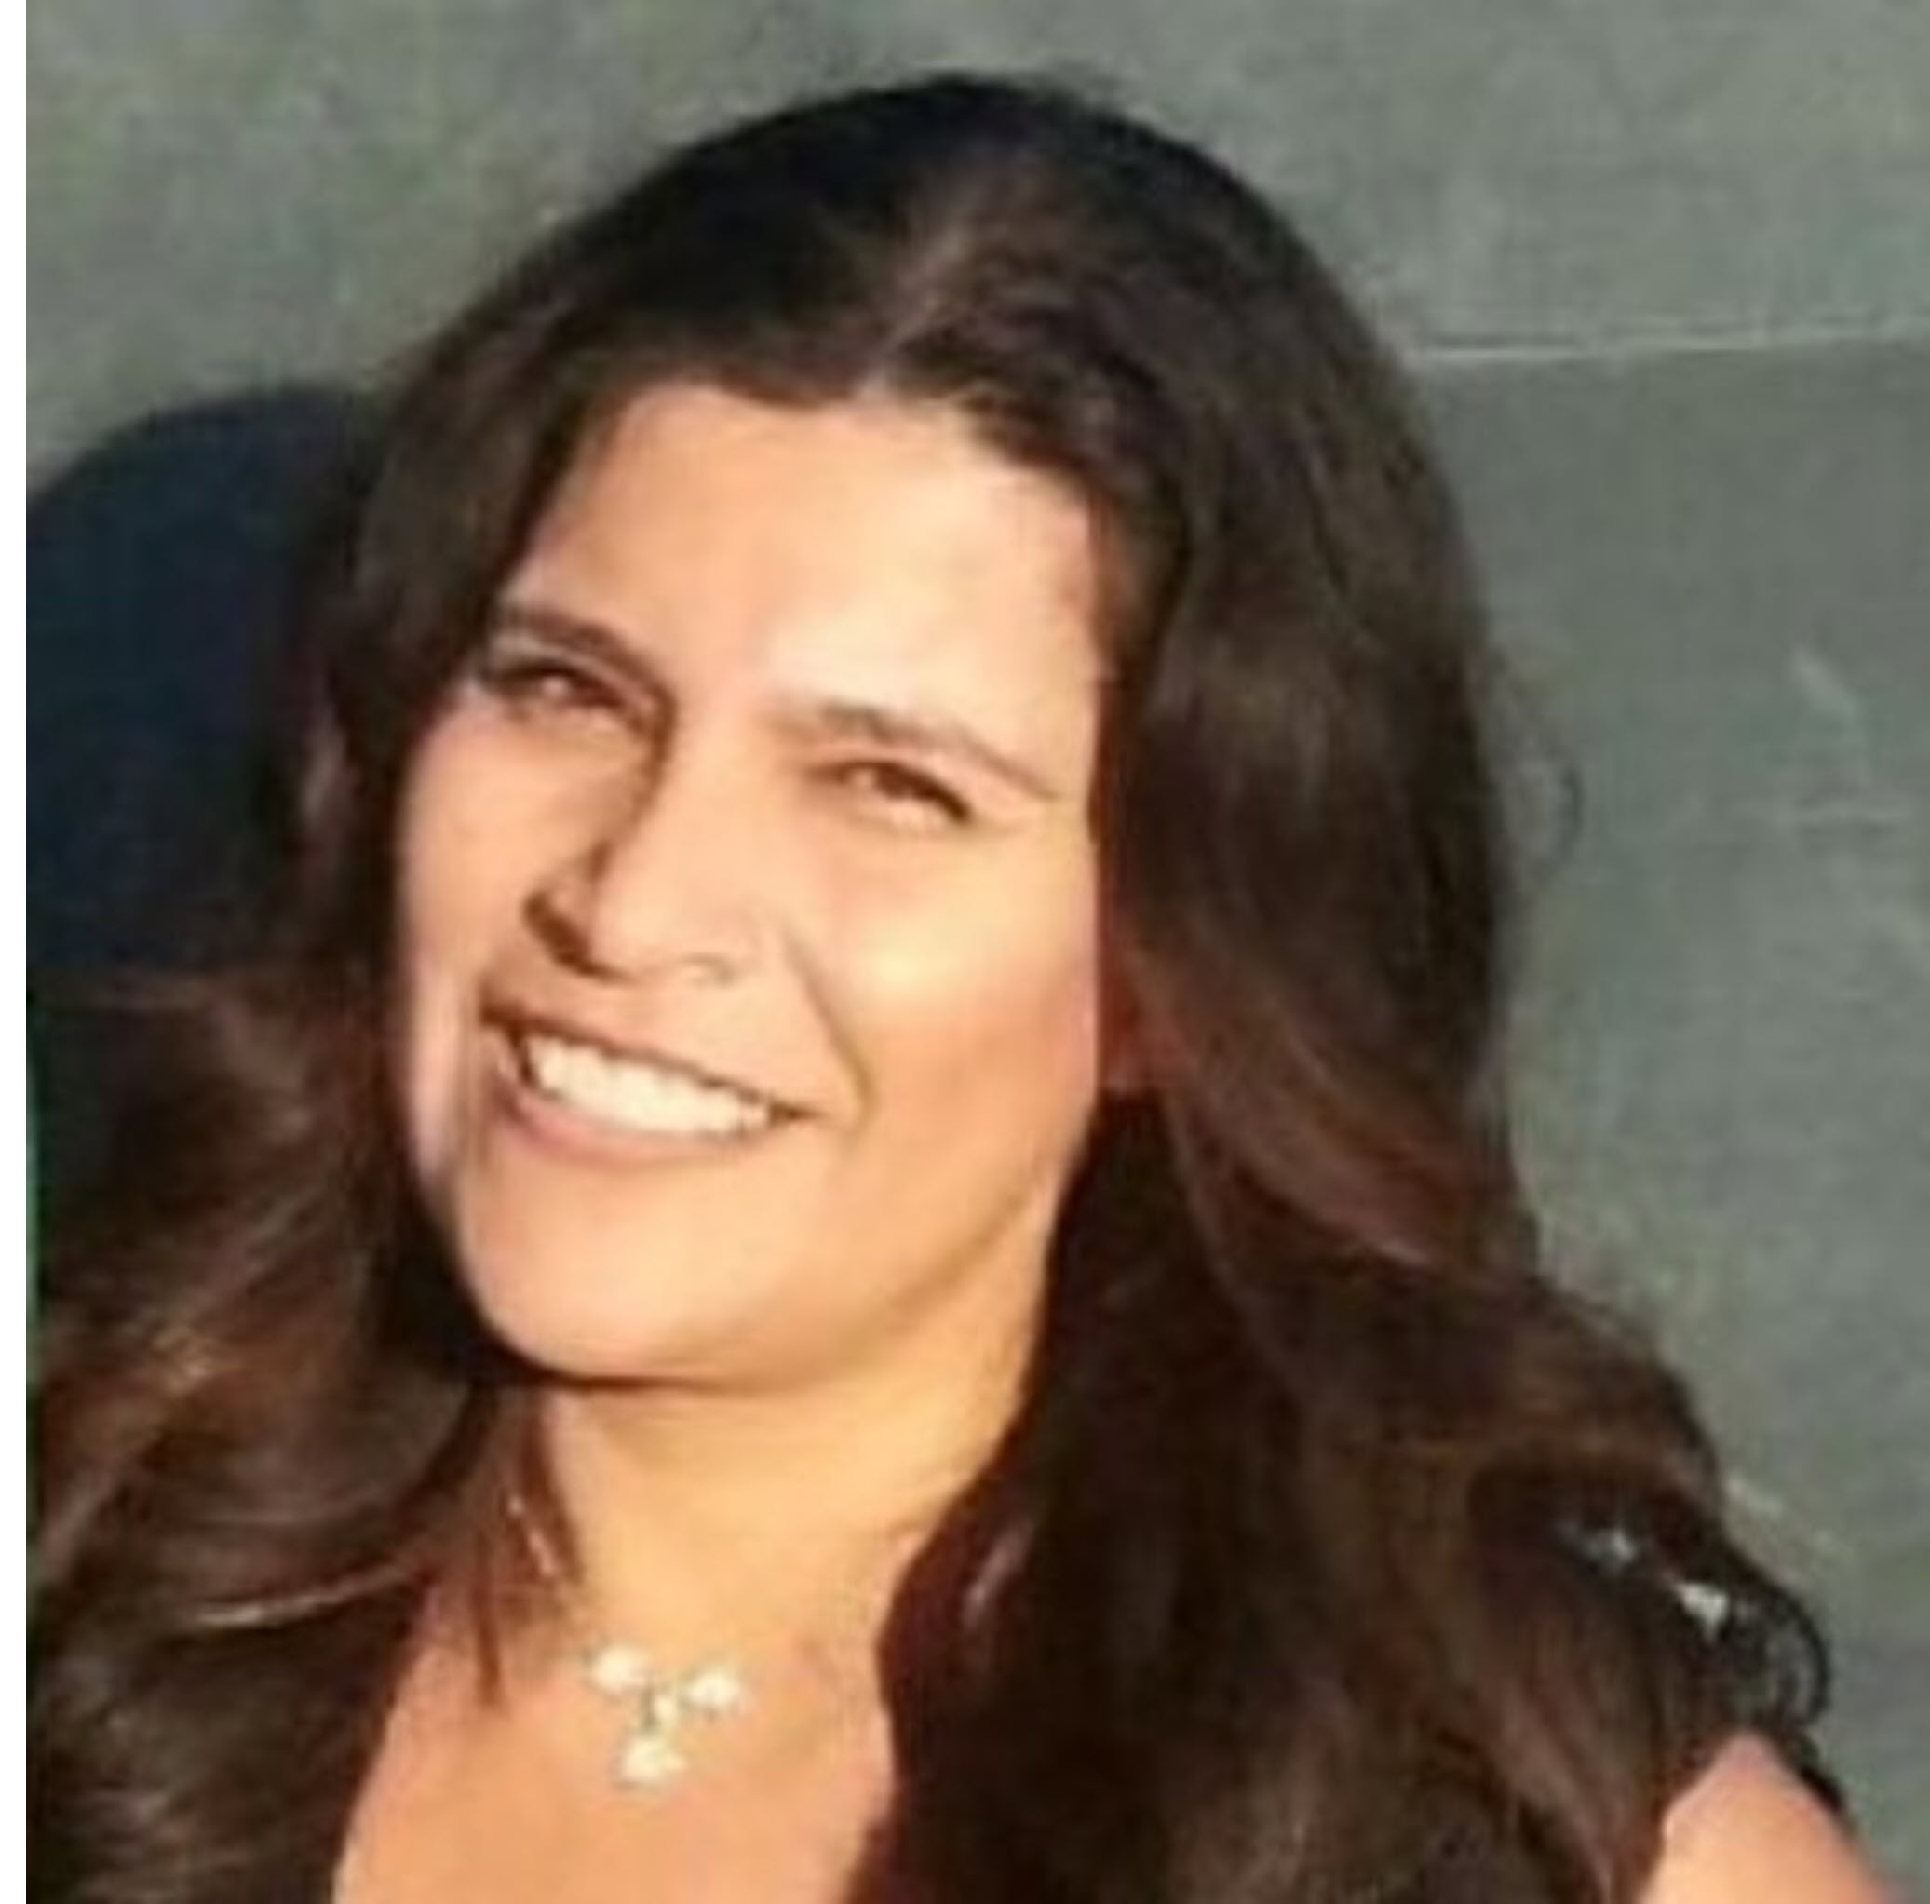

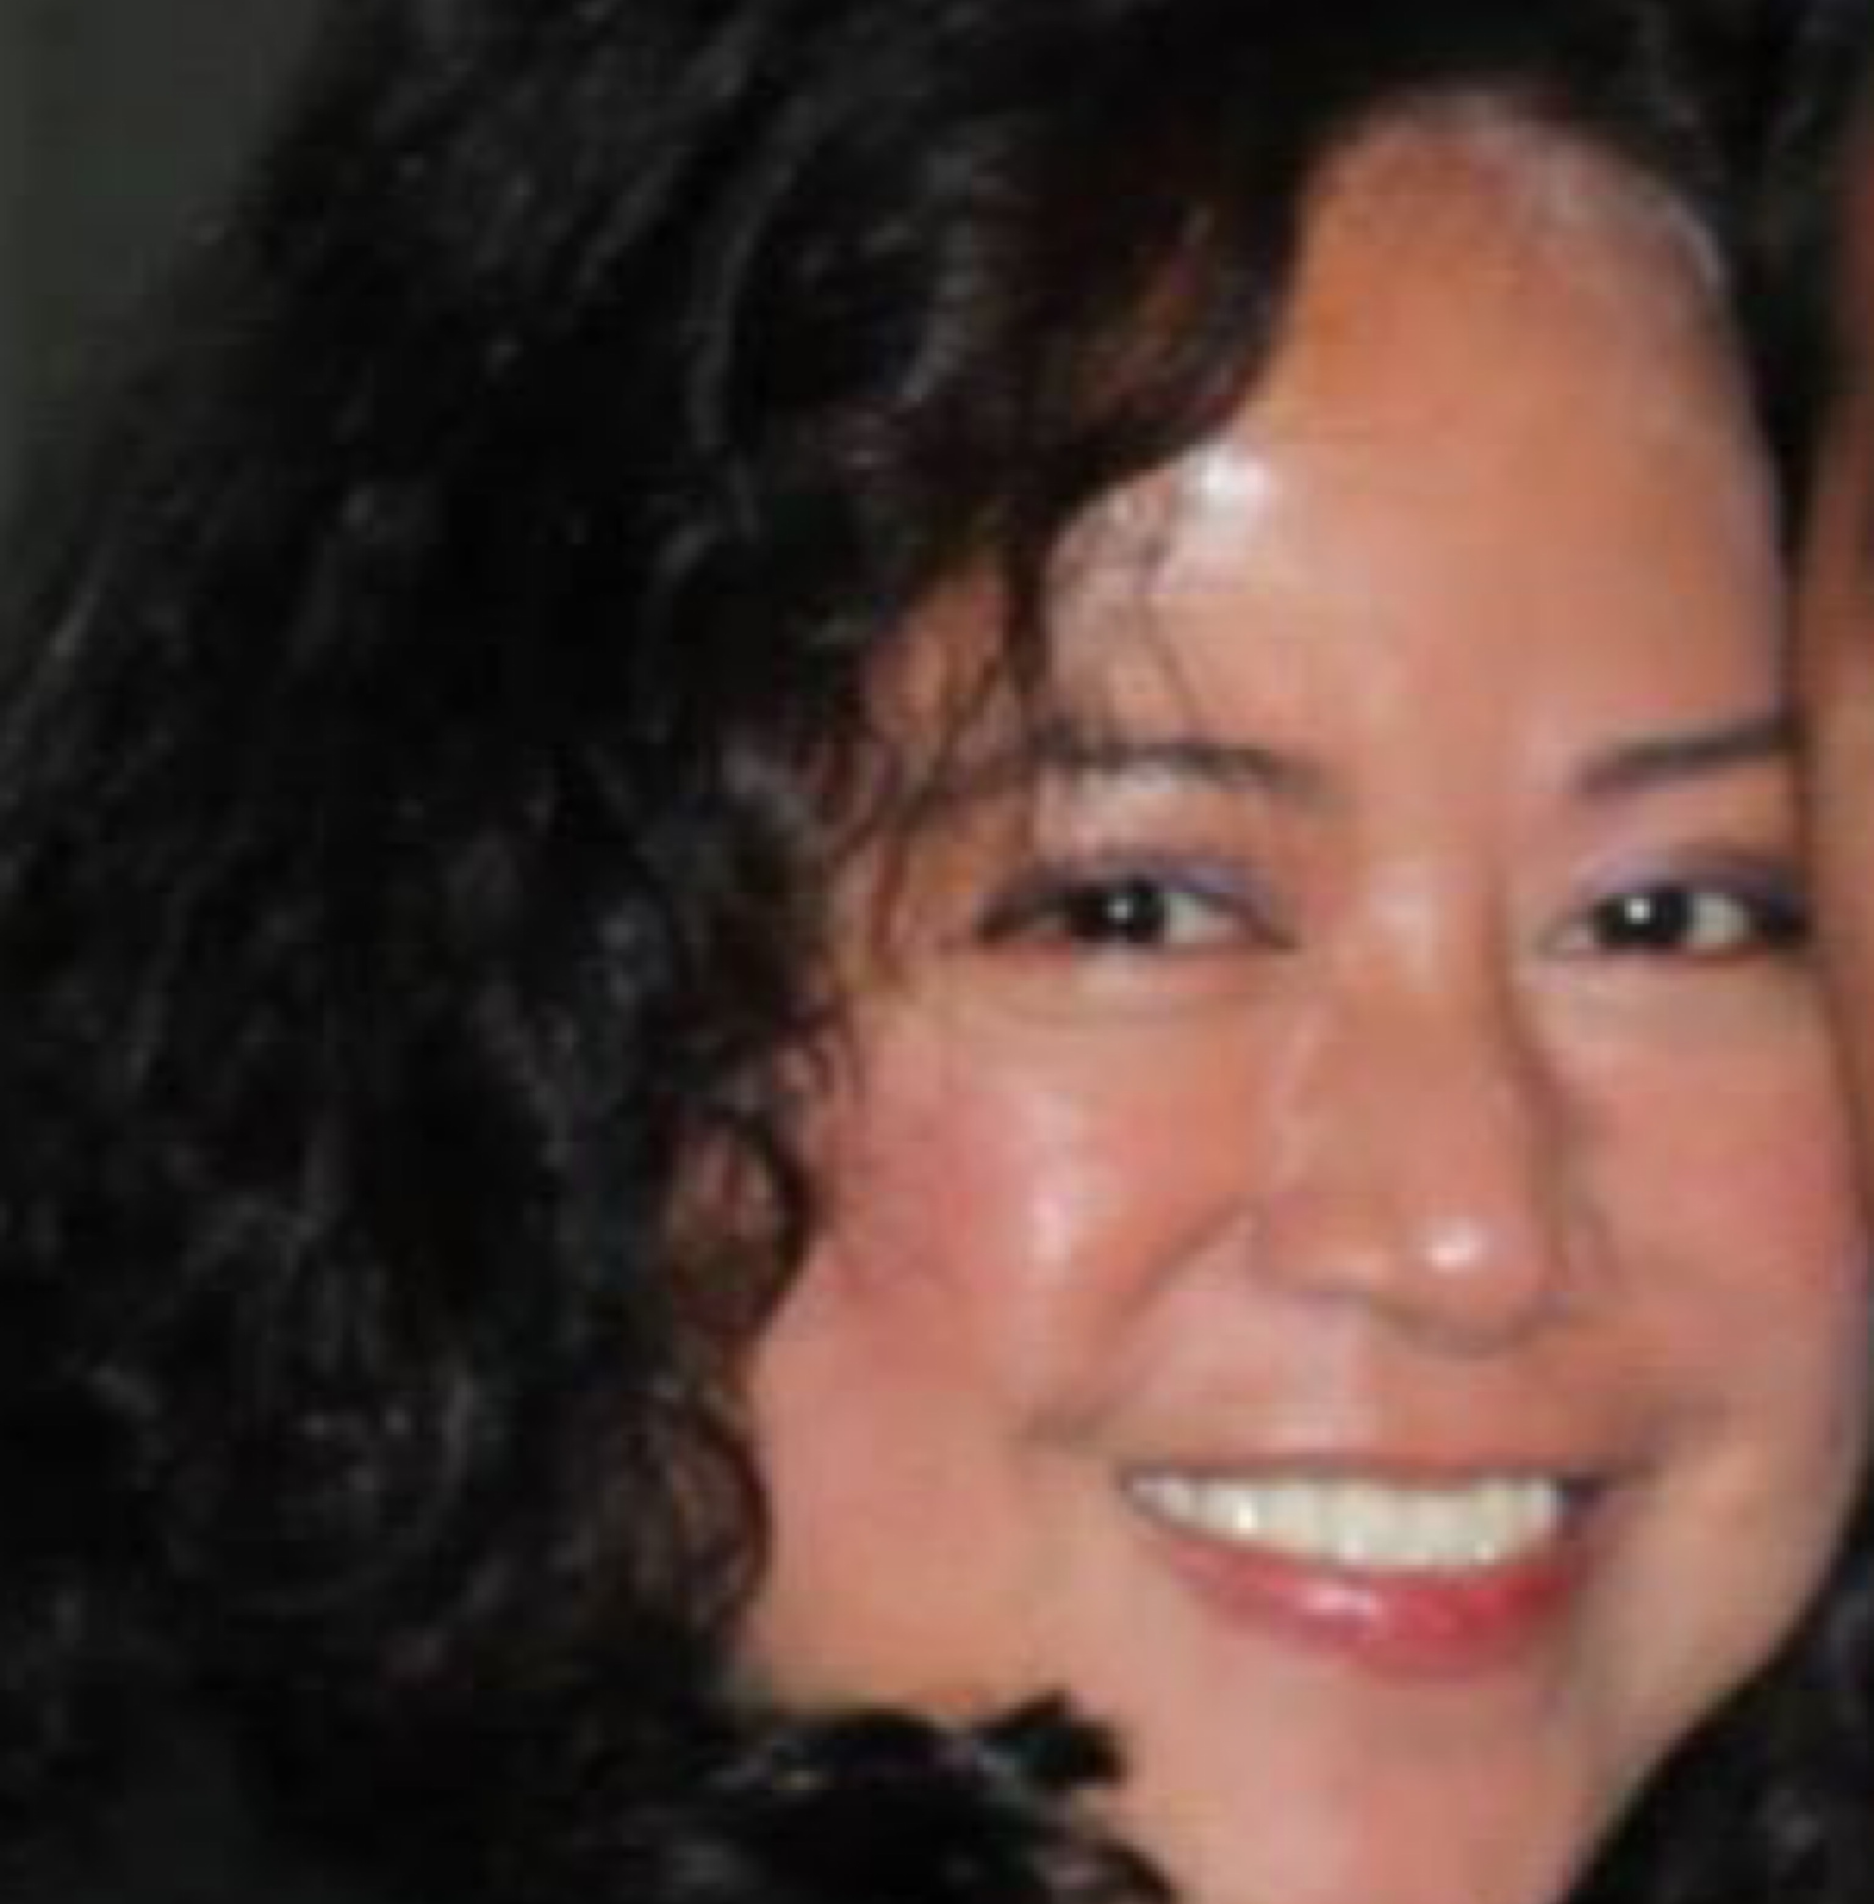

TEAM
Ana Davalos
Diana Chacon
Frances Gliane
Evgeniya Grigoreva

Slide 3
Day 1
Topic - California Power Generation & Power sources
Data Set: https://gis.data.ca.gov/datasets/CAEnergy::california-power-plants?geometry=-147.509%2C31.065%2C-82.163%2C43.271
Inspiration
Ideal Visuals
Proposal

Slide 4
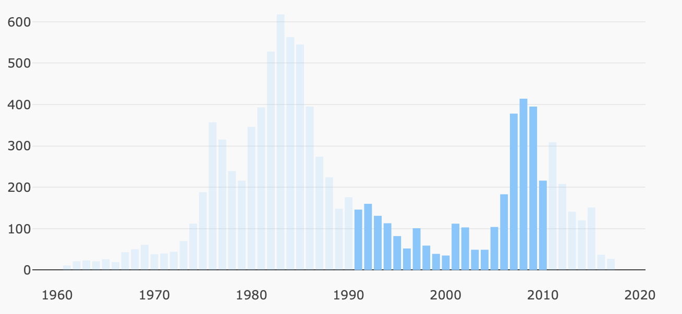
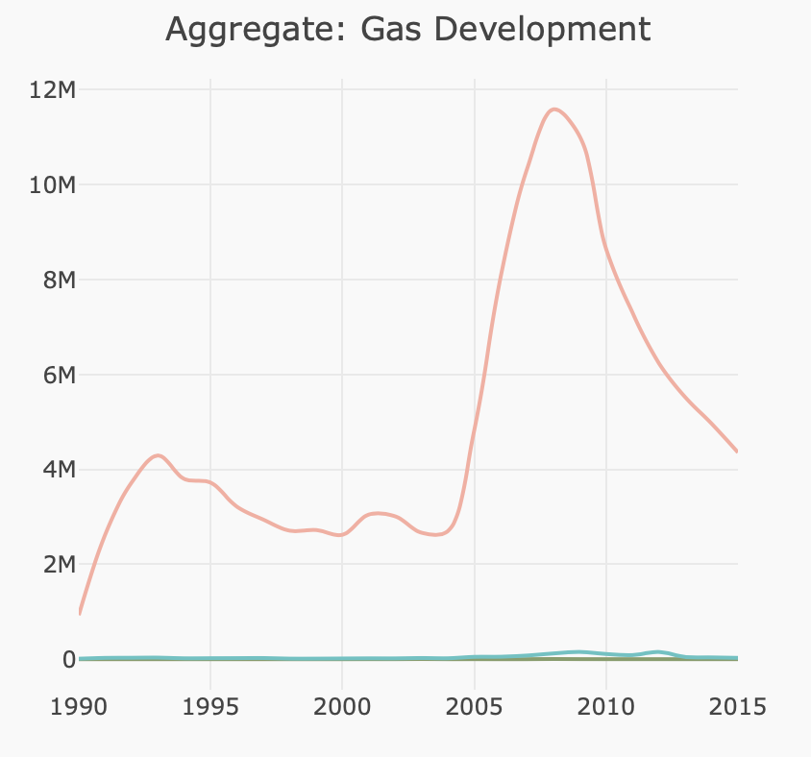
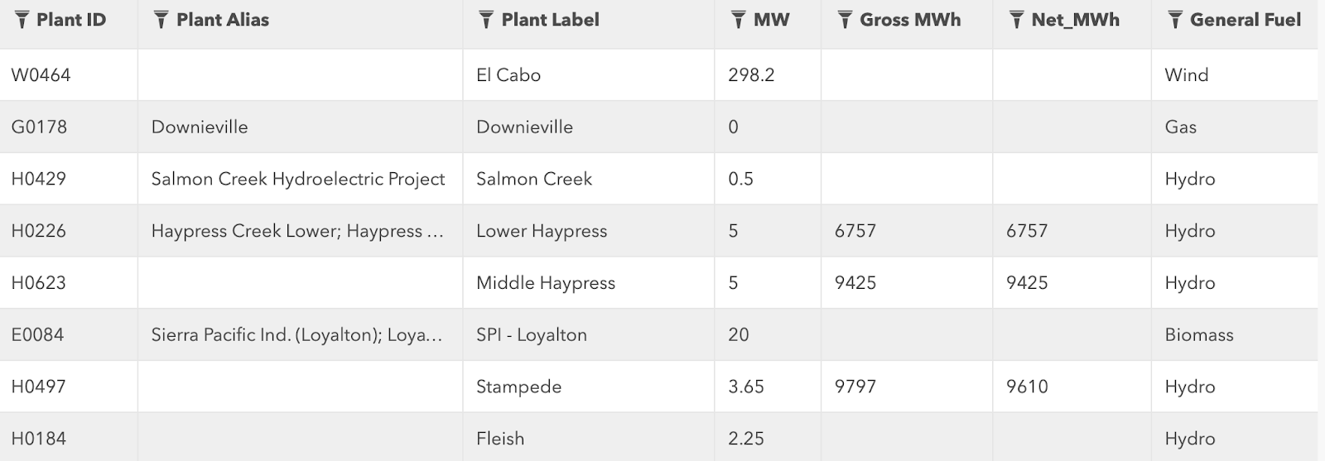
Day 1. inspiration

Slide 5
Day 1. inspiration

Slide 6
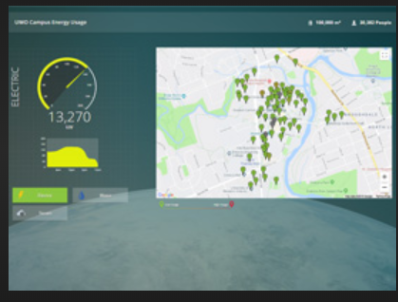
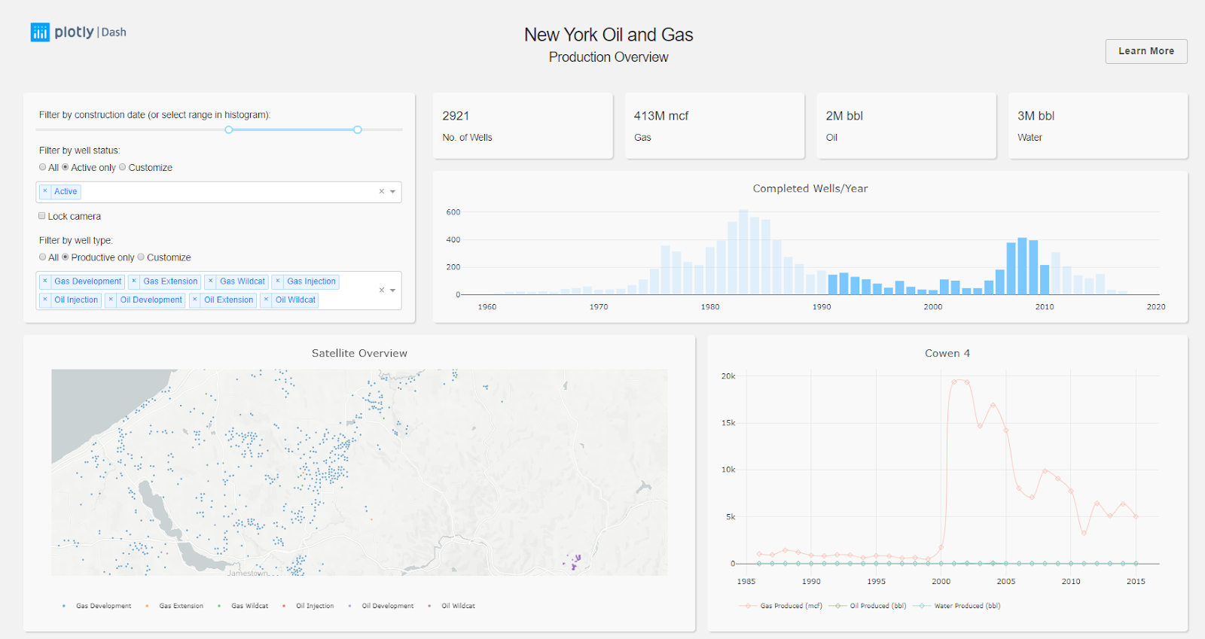
Day 1. inspiration

Slide 7
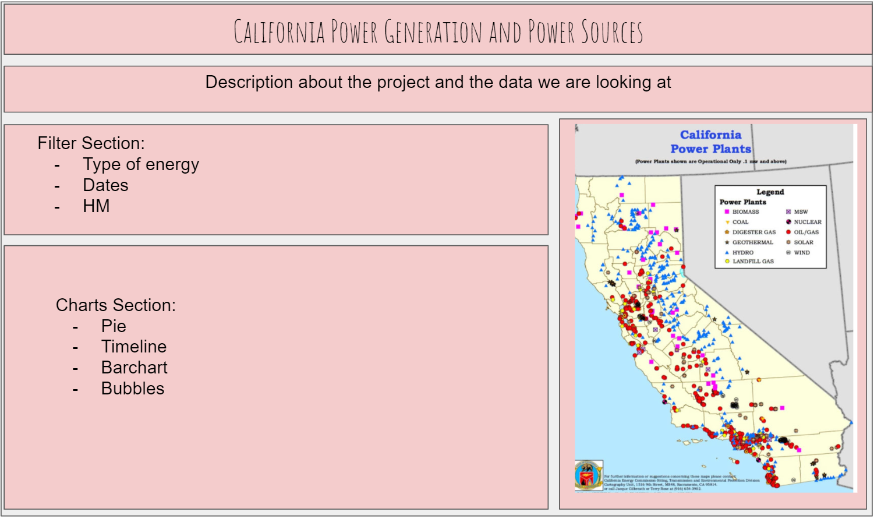
Day 1. UI PROTOTYPE

Slide 8
Day 2
Brief articulation
Metadata
Sketch of the final design
Link to the Primary GitHub: https://github.com/dcchacon/WhoRunTheWorld_Energy

Slide 9
DAY 2. BRIEF ARTICULATION
California has large energy resources, being among the top producers of oil, hydroelectricity, solar, biomass, and geothermal energy in the US. Our dashboard displays installations, consumptions, and distribution.

Slide 10
DAY 2. BRIEF ARTICULATION
California has large energy resources, being among the top producers of oil, hydroelectricity, solar, biomass, and geothermal energy in the US. Our dashboard displays installations, consumptions, and distribution.

Slide 11
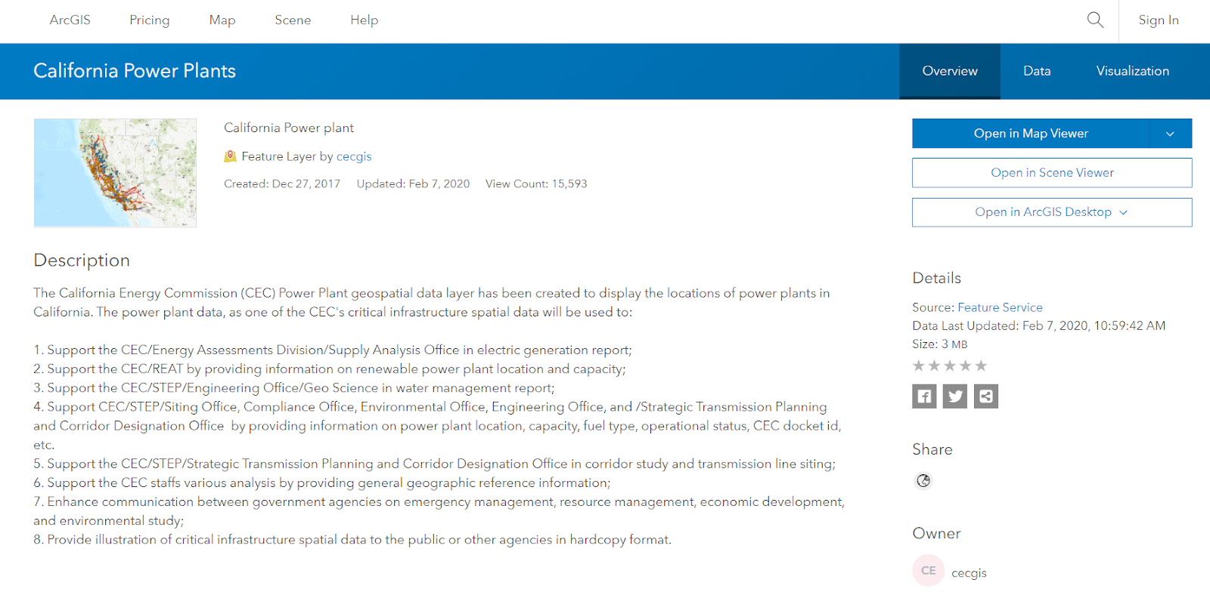
Day 2. METADATA

Slide 12
Day 3
PROJECT ROAD MAP DESIGN
Scrape the date when our dataset was updated
Flask -> GeoJSON (as a file) -> S3
GeoJSON file / READ / ROUTE

Slide 13

JavaScript
Call API
Flask: Use SQLite, to create an API
ML
DATA

Slide 14


Computing Components
NETWORK
PROCESSOR
CLOUD COMPUTING
SERVER

Slide 15
Distribution

Slide 16
Process
Access needed
Determine scale
Select technology

Slide 17

Questions?
Check our GITHUB repository for results:
https://github.com/dcchacon/WhoRunTheWorld_Energy

